Slide 1
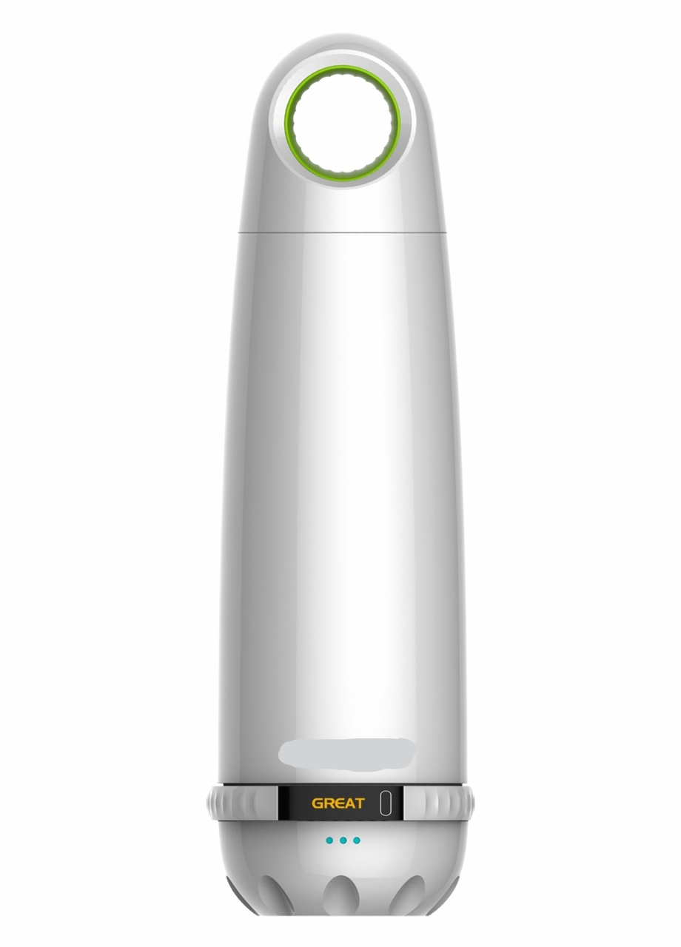
SMART WATER BOTTLE
AUTO TDS
Drink what is Safe..

Slide 2
SHIVAM SHARMA ANIKET KULSHRESHThA
By ,
CSE-G, IInd yr,
Sharda University

Slide 3
INTRODUCTION
Finding pure water to drink is very difficult these days. Even if we get any spot where it is written that the water is filtered the is no any handy gadget to make it sure. This time we have a solution for these kinds of problems using the current technology that we have; which calls for potentially similar solutions to be directed towards solving these issues.

Slide 4
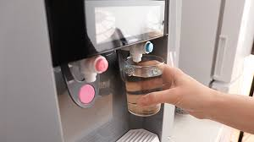
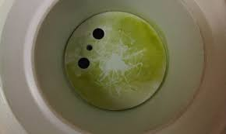
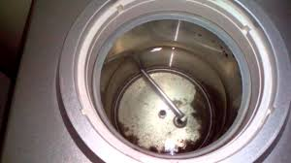
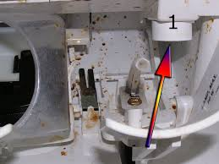
PROBLEM STATEMENT
It’s very difficult to identify that the water we are drinking is pure or not.
Many times it is found that the water cooler/Purifier from which we are drinking water just by reading “Drinking water” but the fact is it has not been serviced since a long time.
Students of schools/Colleges get’s infected by drinking dirty water from their water cooler. Even while travelling it is very important to detect the water is pure or not.
It is not possible for installing water quality checker at every place.
This time we have a solution for these kinds of problems using the current technology that we have; which calls for potentially similar solutions to be directed towards solving these issues.

Slide 5

Water quality parameters
pH
Alkalinity
Dissolved oxygen
Temperature
Turbidity
TDS

Slide 6
Smart bottle – A new approach
A smart water bottle is a new approach to make people aware of what they are drinking. Its is portable & easy to carry that measures different water quality parameters and tells whether the water is safe or not. The design of the bottle is divided into two parts, first is the classic container for the water and second is the water quality meter which measures the quality of the water.

Slide 7
Water quality meter
Using modern techniques, we can measure the water quality.
Signal Readout
Water quality Sensors
Rechargeable Battery
Output Display
Microcontroller unit

Slide 8
THANK YOU

